Slide 1
Unsupervised Pre-training of Graph Neural Networks
Ziniu Hu
3/13/2019

Slide 2
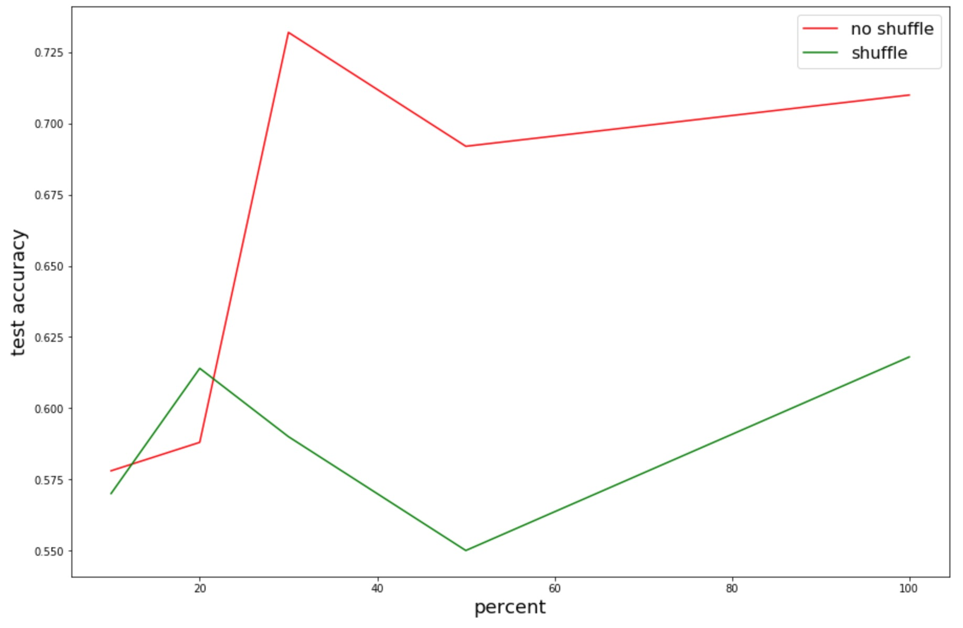
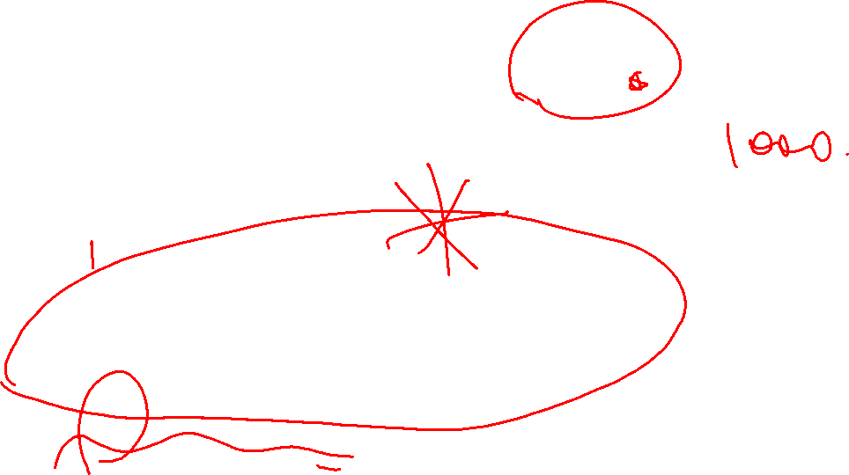
GNN can learn leverage structure, only when data is abundant

Slide 3
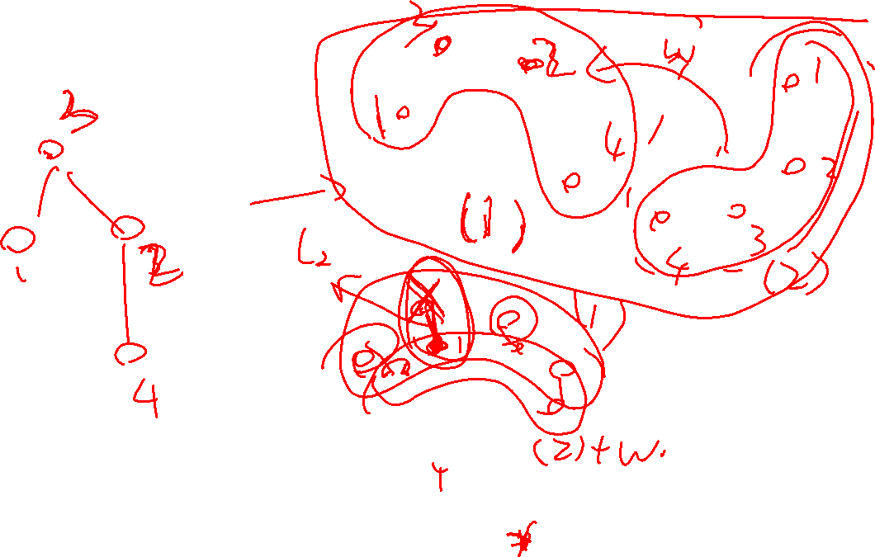

Slide 4
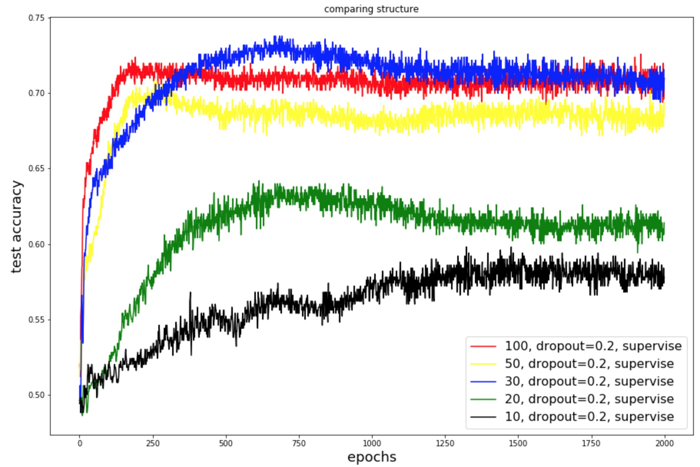
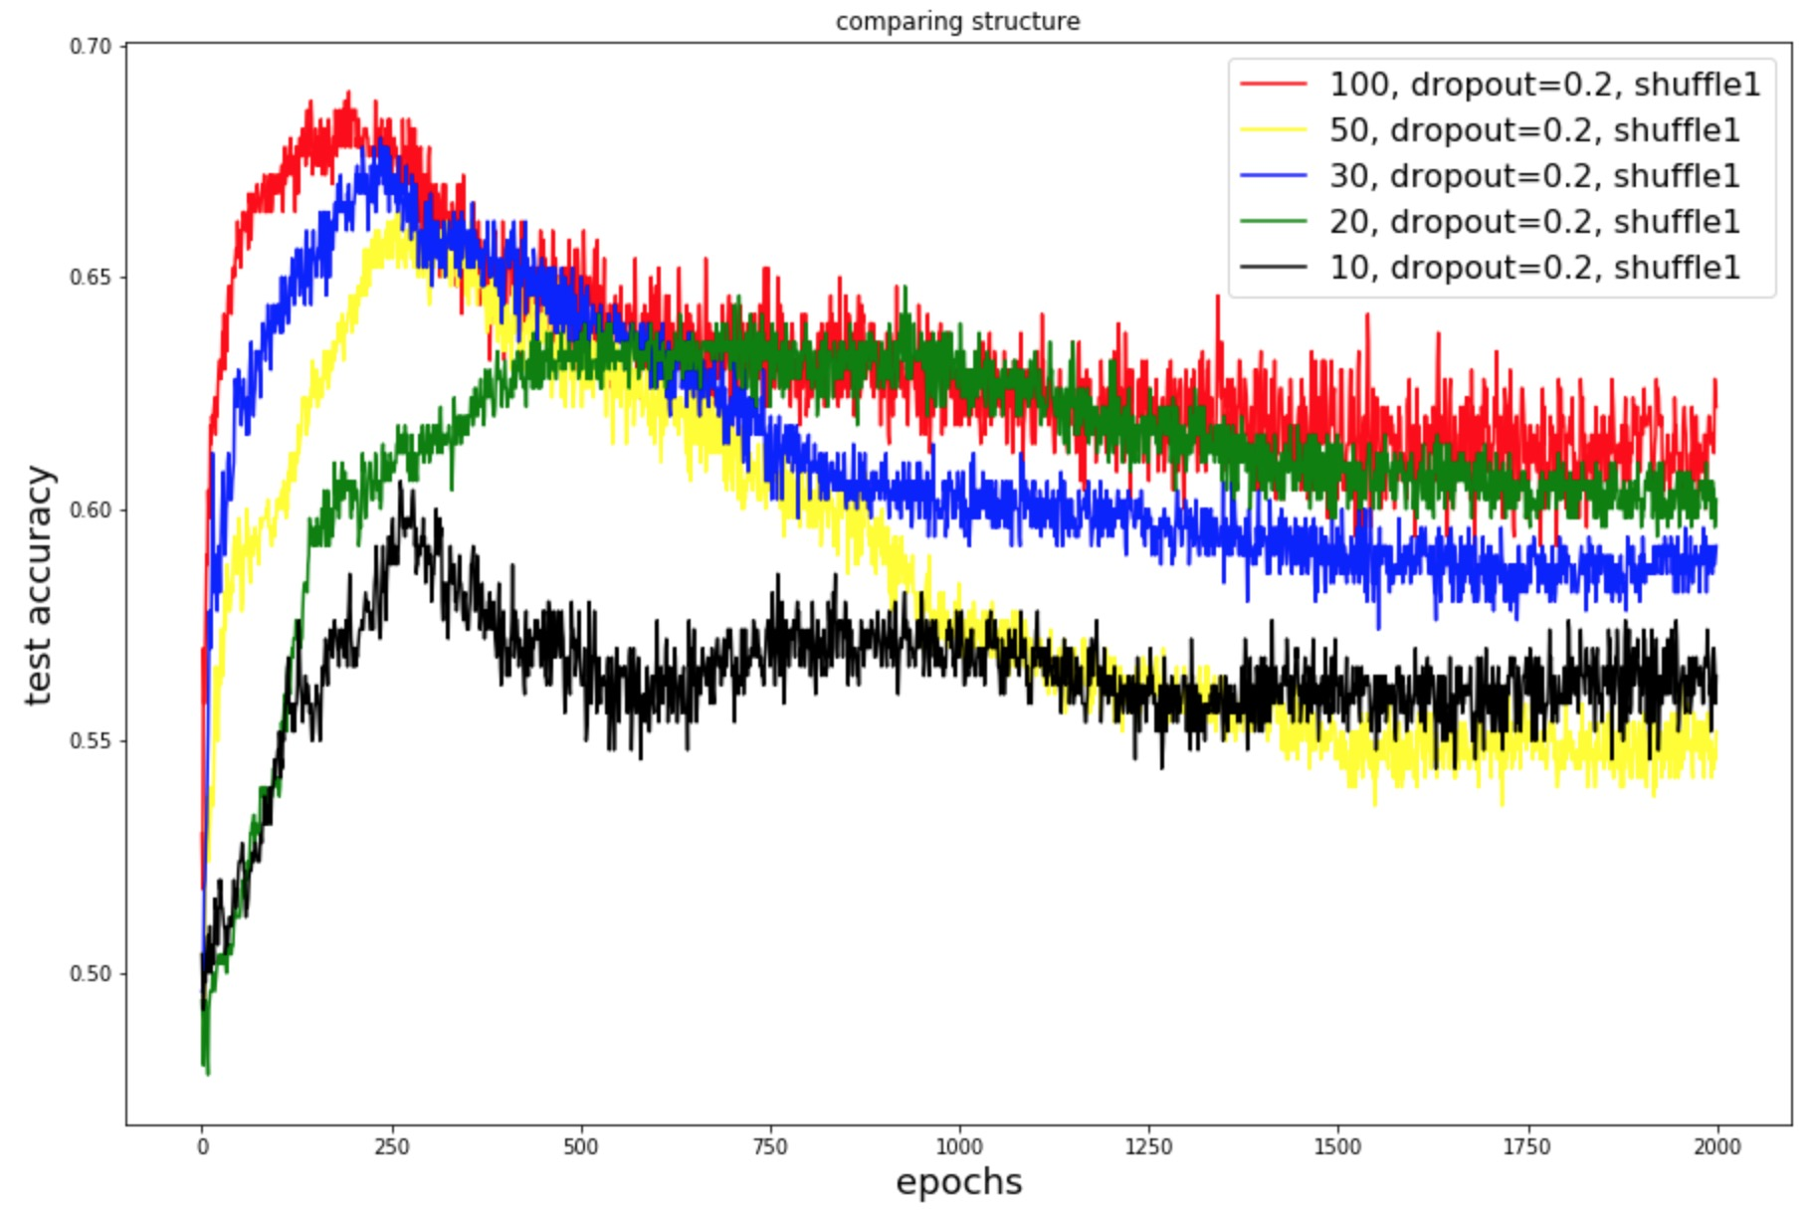
GNN can learn leverage structure, only when data is abundant

Slide 5
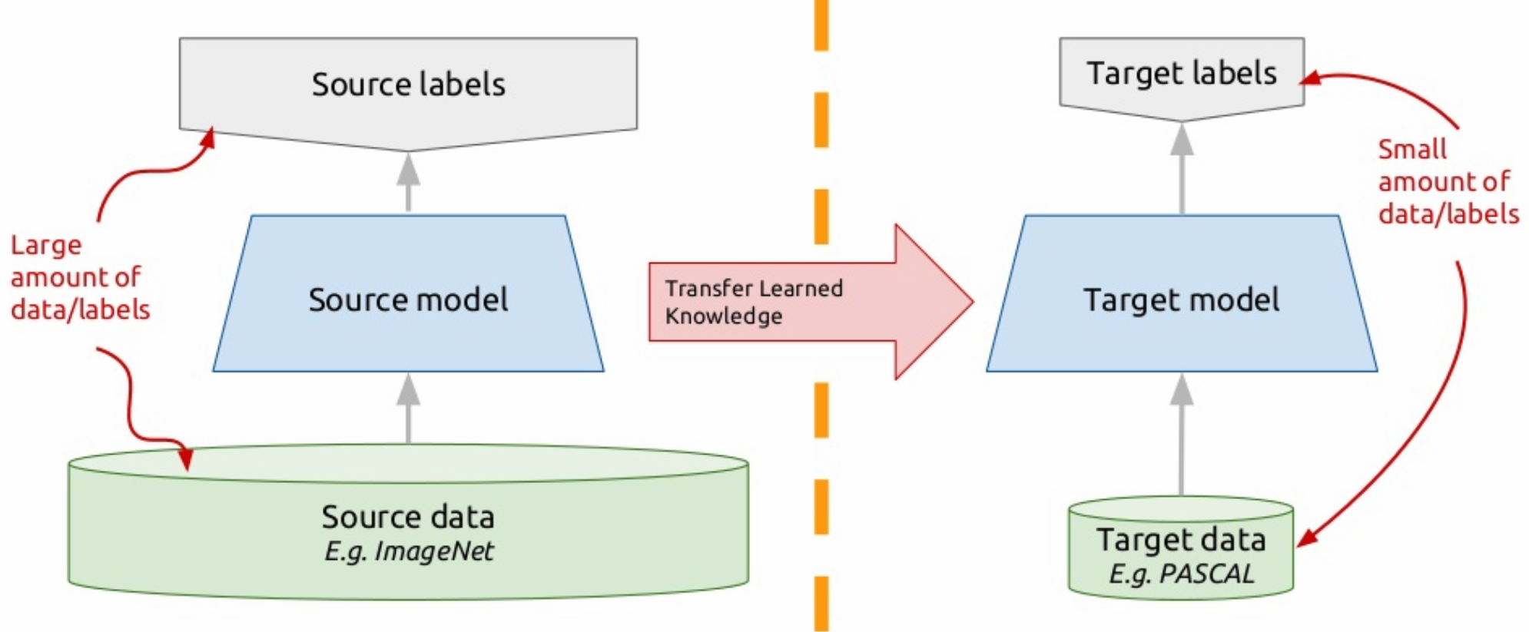
Why Unsupervised Pre-training
Data
Labelled data is limited
unsupervised data is abundant
Regularization
transfer knowledge from a related tasks

Slide 6
How to conduct pre-training in CV and NLP
Find Transferable Feature
RGB Pixels for images
Shared word embedding for a given language
Some tricks for multi-lingual texts
Find informative pre-training tasks
Supervised (Image-Net, Machine Translation)
Unsupervised (Language Model, Auto Encoder)
Fit on Downstream Tasks
Feature Extractor (ELMO)
Fine-Tune (BERT)

Slide 7
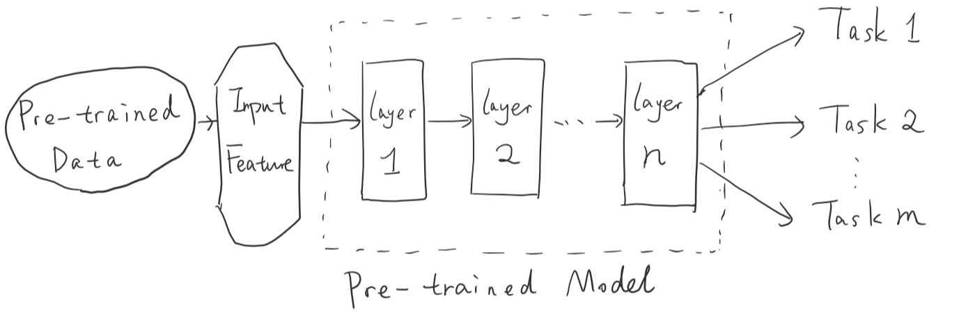
(Pre-train Stage)
(Adapt Stage)
Feature Extractor (ELMO)
Fine-Tune (BERT)

Slide 8
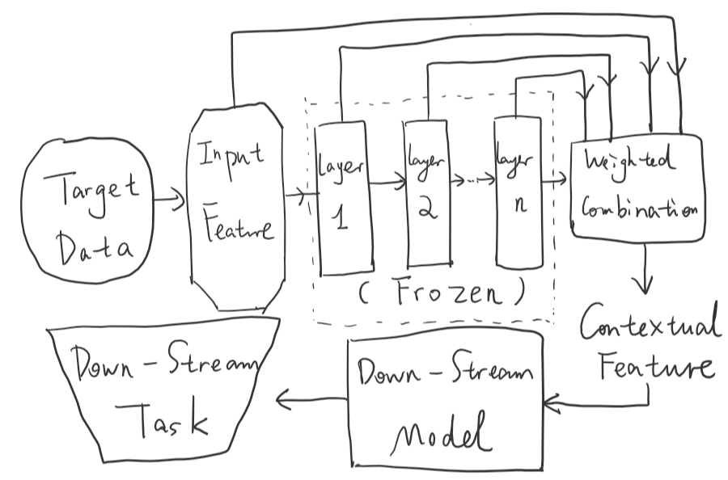
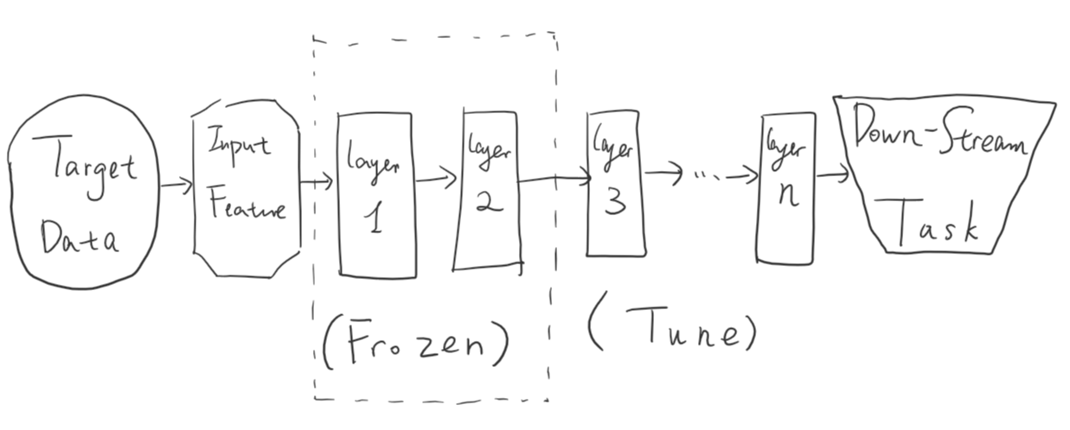
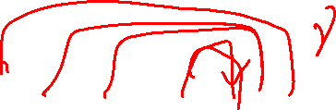

(Pre-train Stage)
(Adapt Stage)
Feature Extractor (ELMO)
Fine-Tune (BERT)

Slide 9
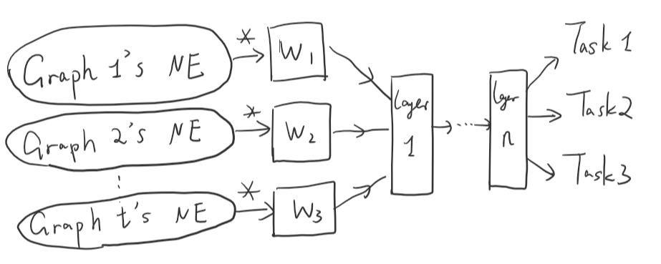
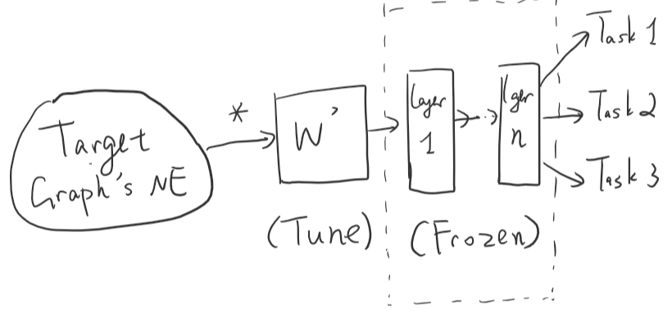

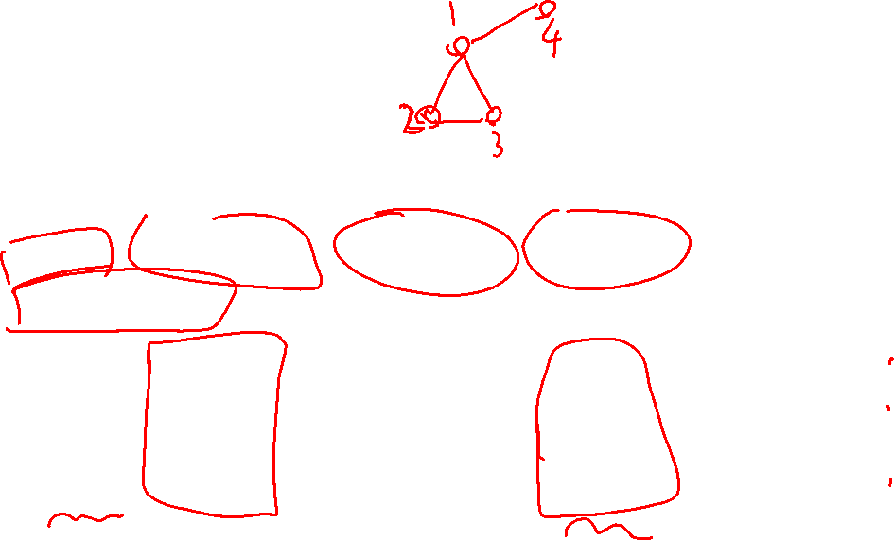
Pre-training for GNN
Find Transferable Feature
Current datasets normally have ad-hoc features
Proper unsupervised features:
Degree, Local Cluster coefficience, graph kernel, etc
Node Embedding (Naturally Transudative. Whether can we align?)
Ad-hoc features (Future work, challenging)
Whether can we align them to get universal representation too?

Slide 10
Pre-training for GNN
Find informative pre-training tasks
Local Structure:
Graph Reconstruction (Masked Link Prediction)
Global Structure:
Ranking Estimation of Closeness, PageRank, Degree
Graph-level Structure:
Graph Edit Distance

Slide 11

Pre-training for GNN
Fit on Downstream Tasks
Have tried both fine-tuning and feature extractor
Change to extreme scares setting (5% train; 5% valid; 90% test)
For degree, fine-tune can enhance about 3-4%, while feature extractor can enhance 10-14%.
Degree Feature | Downstream Tasks | No Pretrain | Random Graph (Finetune) | Random Graph (Feature Extractor)
Reconstruction | Cora (Node Classification) | 0.565 ± (0.010) | 0.590 ± (0.009) | 0.639 ± (0.014)
 | Movie (Link Classification) | 0.535 ± (0.008) | 0.587 ± (0.008) | 0.603 ± (0.011)
Rank | Cora (Node Classification) | 0.565 ± (0.010) | 0.571 ± (0.007) | 0.586 ± (0.008)
 | Movie (Link Classification) | 0.535 ± (0.008) | 0.576 ± (0.006) | 0.593 ± (0.009)
Rec + Rank | Cora (Node Classification) | 0.565 ± (0.010) | 0.588 ± (0.011) | 0.632 ± (0.013)
 | Movie (Link Classification) | 0.535 ± (0.008) | 0.591 ± (0.009) | 0.609 ± (0.012)

Slide 12
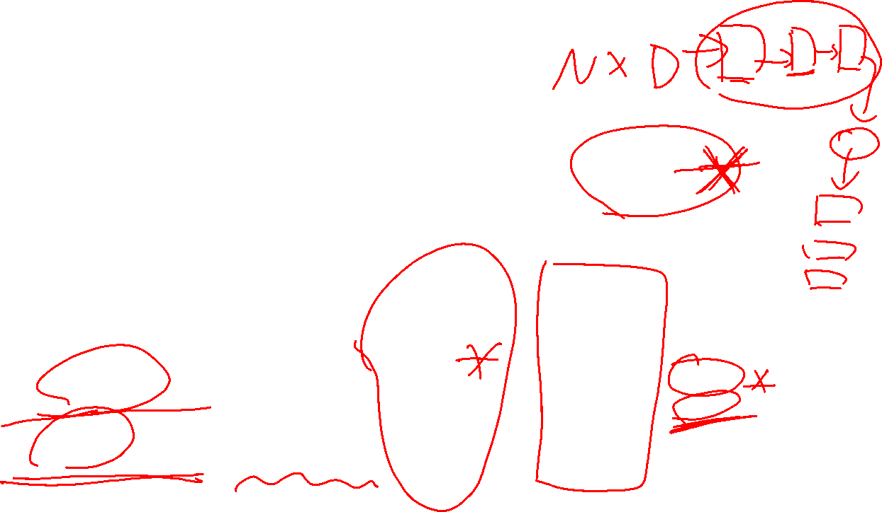
Pre-training for GNN
Fit on Downstream Tasks
For node2vec, fine-tune can enhance about 1%, while feature extractor can enhance 2%. (Using feature, cora is 0.82)
It shows that feature extractor is more effective to current GCN, maybe because the pre-train layer is not enough (but can train a deep NN when adding self-attention, skip connection, etc).
Node2vec | Downstream Tasks | No Pretrain | Random Graph (Finetune) | Random Graph (Feature Extractor)
Reconstruction | Cora (Node Classification) | 0.779 | 0.784 | 0.791
 | Movie (Link Classification) | 0.736 | 0.741 | 0.748
Rank | Cora (Node Classification) | 0.779 | 0.789 | 0.796
 | Movie (Link Classification) | 0.736 | 0.747 | 0.753

Slide 13
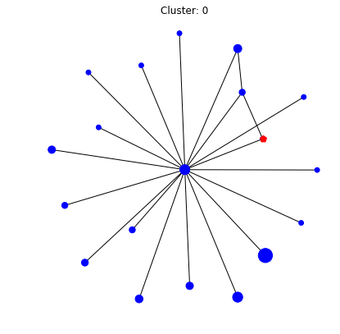
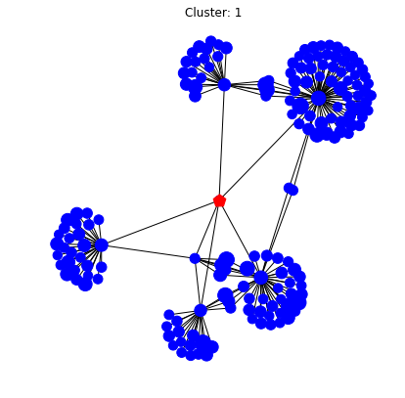
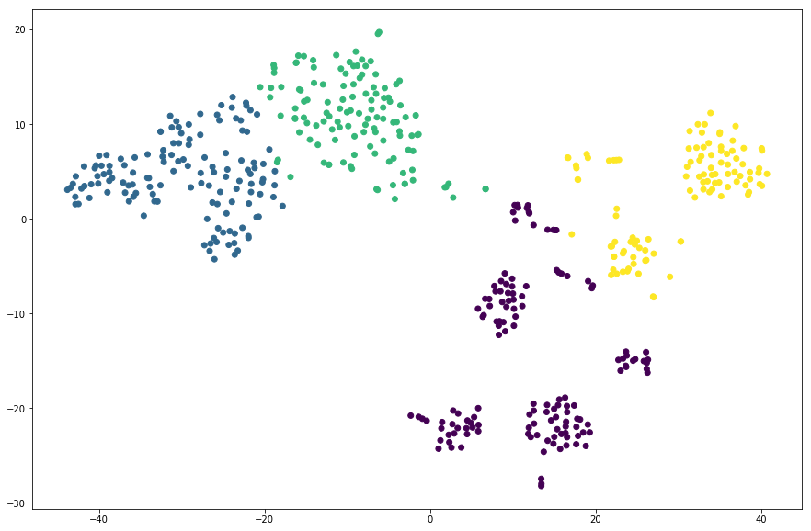
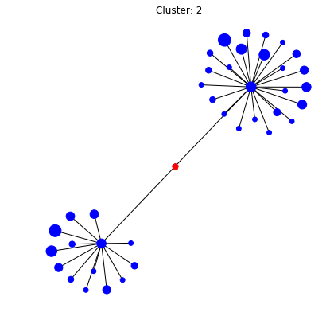
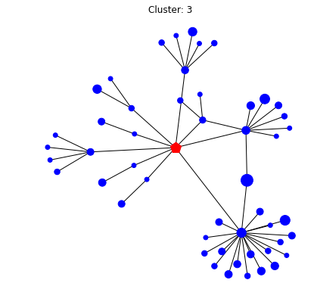
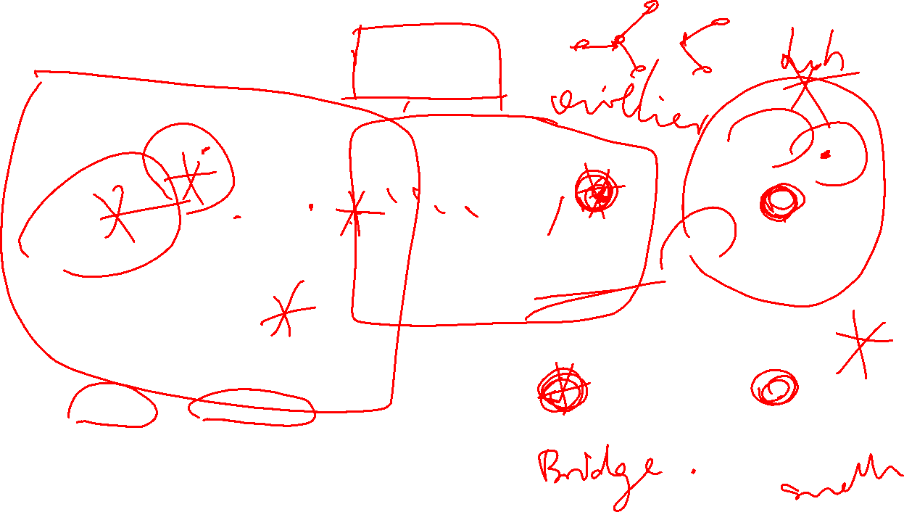
Visualization of 2-layer GCN
Pick 500 nodes from different graphs, with highest activation. Plot and cluster via TSNE

Slide 14
Contribution of this work
Propose three unsupervised pre-training and show that they can benefit down-stream tasks with simple universal features.
Propose a pre-trained based alignment approach to align network embedding on different graphs, and show sota result compared even to useful features.
Show that feature extractor is efficient to current GCN + pretraining setting.

Slide 15

Submission Plan
ICLR’19 Workshop: Representation learning on graphs and manifolds
DDL: 3.22
4 pages (article) + 4 pages (ref + appendix)
Goal:
Finish core experiment (3 pretrain * 10 down-stream)
train deeper? (whether deeper pre-train can enhance performance.
NIPS’19
DDL: 5.18 (last year’s ddl)
Goal:
Try different alignment method for node embedding
Try best to add in different feature alignment

Slide 16
